Slide 1
Indivo X: The Open-Source Personally Controlled Health Record Platform
Daniel Haas, Ben Adida, Arjun Sanyal,
Isaac S. Kohane, Kenneth D. Mandl
Harvard Medical School
Children’s Hospital Informatics Program
OSCON: Healthcare Track
27 July 2010

Slide 2
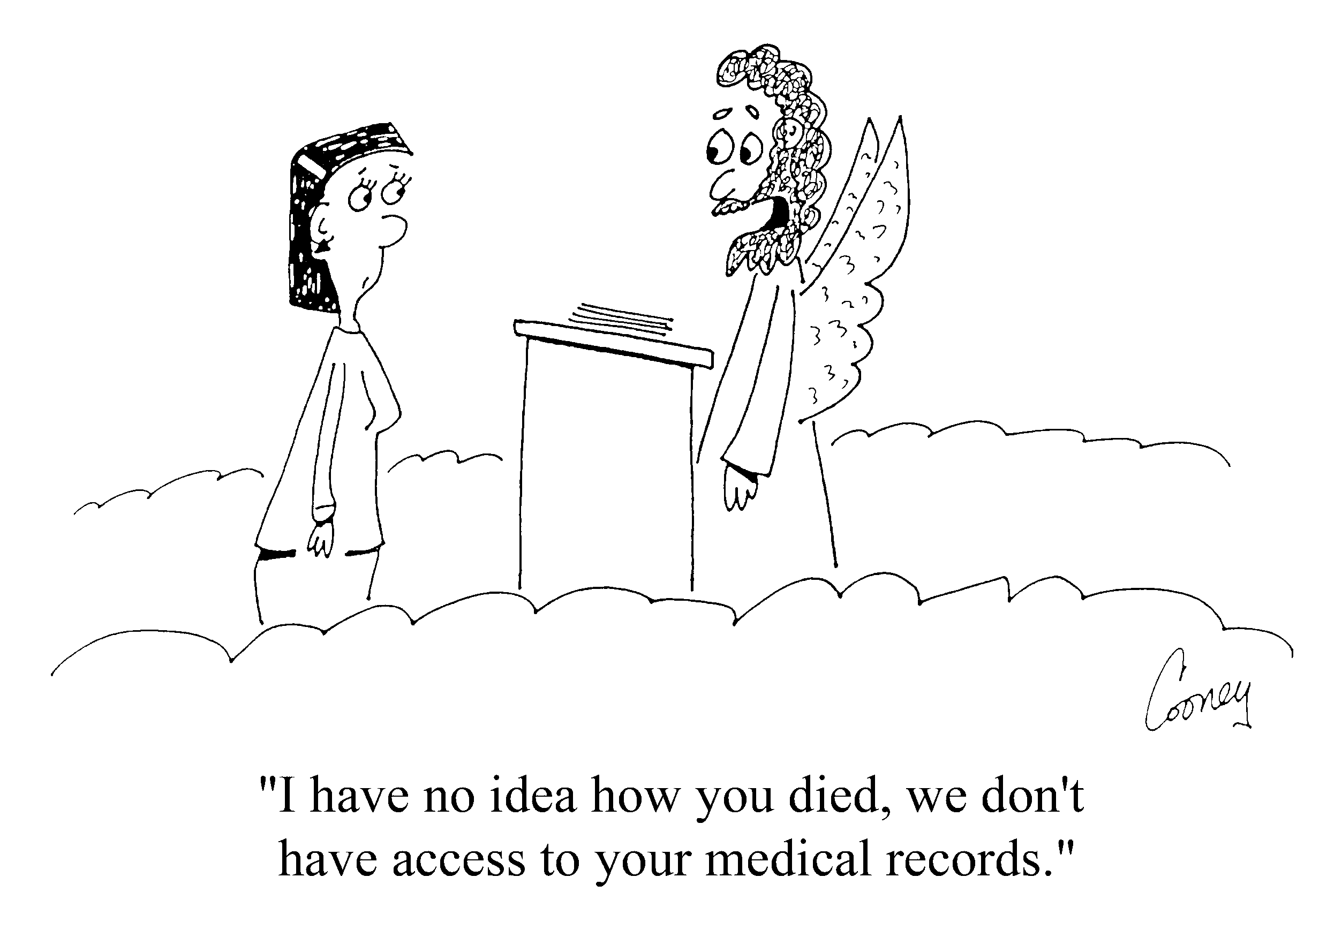
Notes:
-The Indivo Project, which I will be discussing today, arose out of this observation: namely, it is oddly difficult for patients to get access to their medical data, given that it’s THEIRS.

Slide 3
In 1994 we observed that institutions rarely share data
x
x
H1
H2
H3
Proprietary
Perceived competition
Privacy
Health Insurance Portability and Accountability Act
No dedicated resources to do so
Notes:
-hospitals don’t want to let other hospitals see patterns of care: implications for vendor contracts, comparison of care standards, etc.
-this is a weird model: data doesn’t magically come together at the same time.
-shouldn’t expect institutions to actively cooperate to make sure you have your data

Slide 4
Patients need an aggregate view on the data
H1
H2
H3
Indivo Server
Notes:
-Indivo Inverts this model: patient actively controls data flows
-Collection of patient records is a population health database: ripe for research.

Slide 5
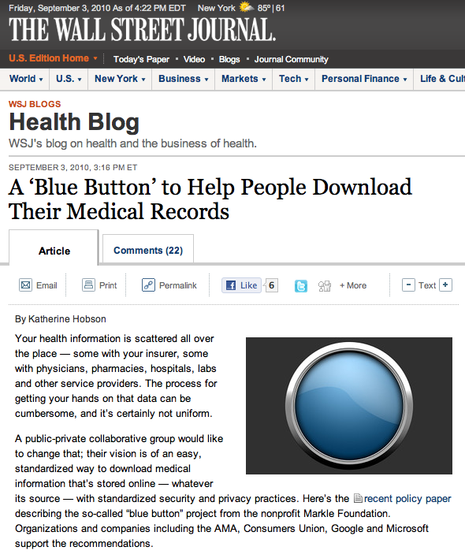
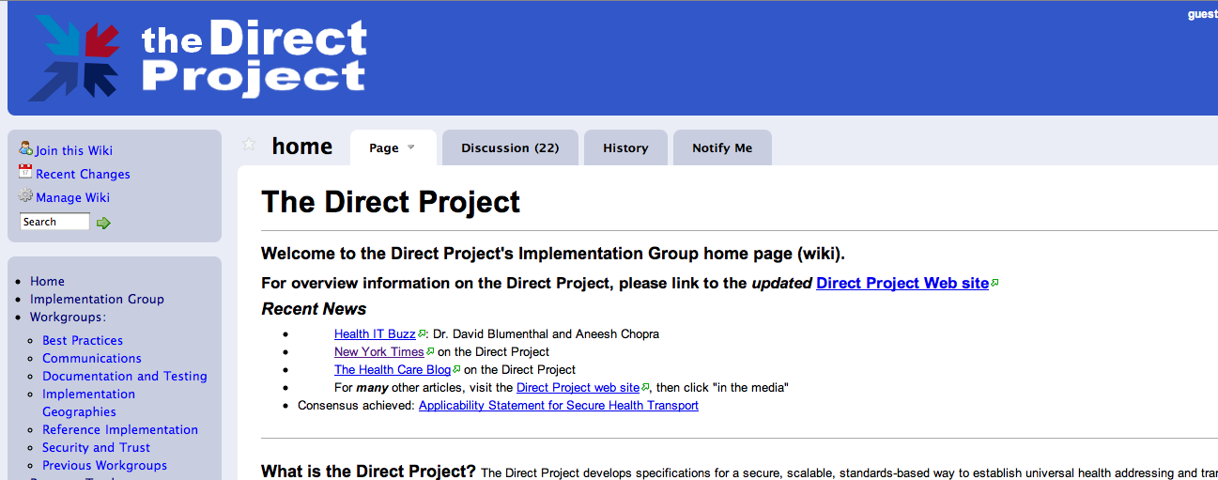
Is Data Liquidity
Upon Us?
Notes:
-A number of projects are springing up with the promise of facilitating data exchange. Here are two.
-These projects are ambitious and great, but in order for a patient to truly take control of their care, we need systems like Indivo ready to receive the data and add value to it.
And with that, I’ll throw some links back up on the screen and open up the floor to questions.

Slide 6
Our original statement on personal control
A PCHR should store all of an individual’s medical history in a container with:
  patient control
  interoperability
  open standards
Notes:
Trust is crucial to a personal health record system, and patient control creates that.
-first statement in 2001 (NEJM)

Slide 7
The Addition of Substitutable Apps
Push innovation to the edges
Nimbly evolve functionality
Avoid vendor lock
Shrink switching costs
Enable disruption

Slide 8
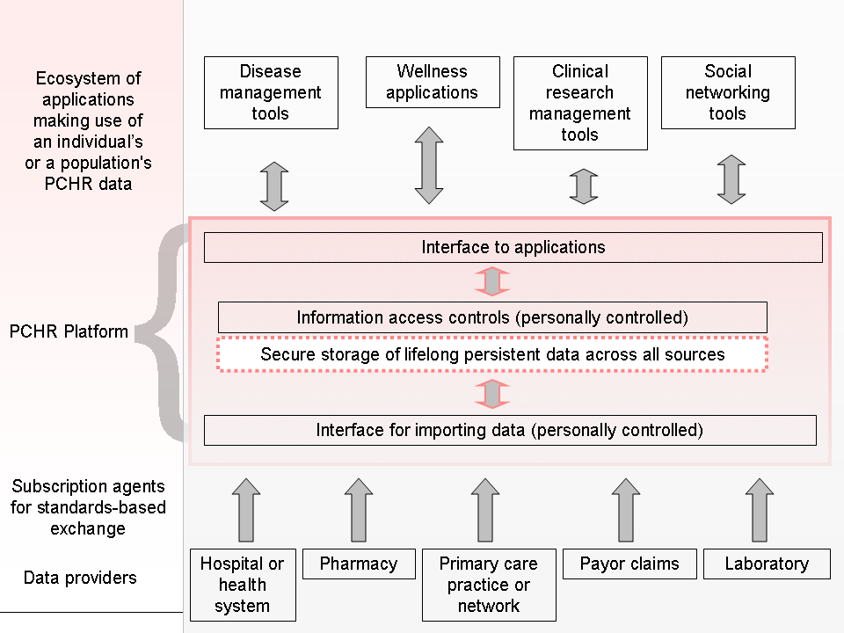
Notes:
-Indivo is a repository with a Data Model
-It does two things: acquire data from multiple sources, and let you interact with that data via apps
-business is not in the storage: it is in the apps

Slide 9
Why Open-Source a PCHR
Enable innovation
Enable customization
Involve the community
Avoid instance lock-in
Avoid vendor pull-out
Apps don’t need to be open-source (but they can be easily substituted by ones that are)
Notes:
-Tie to App Model: We wanted 3rd parties to contribute value to the system: open-source is the logical extension of that.
-Customization: new UI, or just a couple new schema types
-Lock-in and pull-out: You can run Indivo from your PC. If someone forks Indivo and does better, you can install that.
-Community is the best use case: getting community involvement ensures that we build software that’s valuable to the patient (easy to forget in an academic setting).

Slide 10
Let’s Get Technical
The Stack:
  Ubuntu (Or CentOs, RHEL, OSX)
  Postgres (Or Oracle, MySQL)
  Python
  Django
  Apache (w/ mod_wsgi)
The Verbs:
  Connect
  Add Apps
  Share
The Vocab:
  Account
  Record
  Document
  App

Slide 11
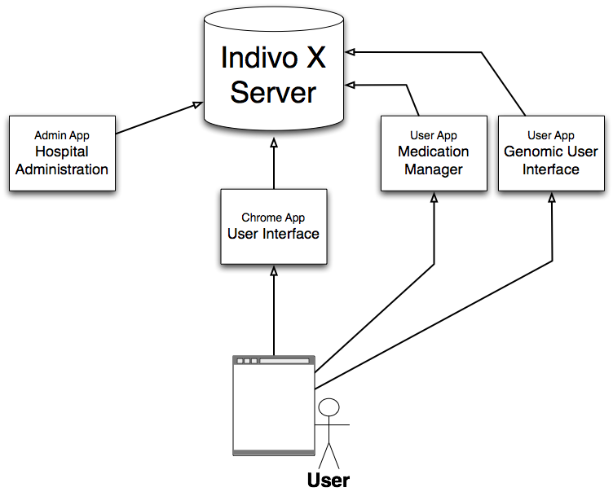


Platform Architecture

Slide 12
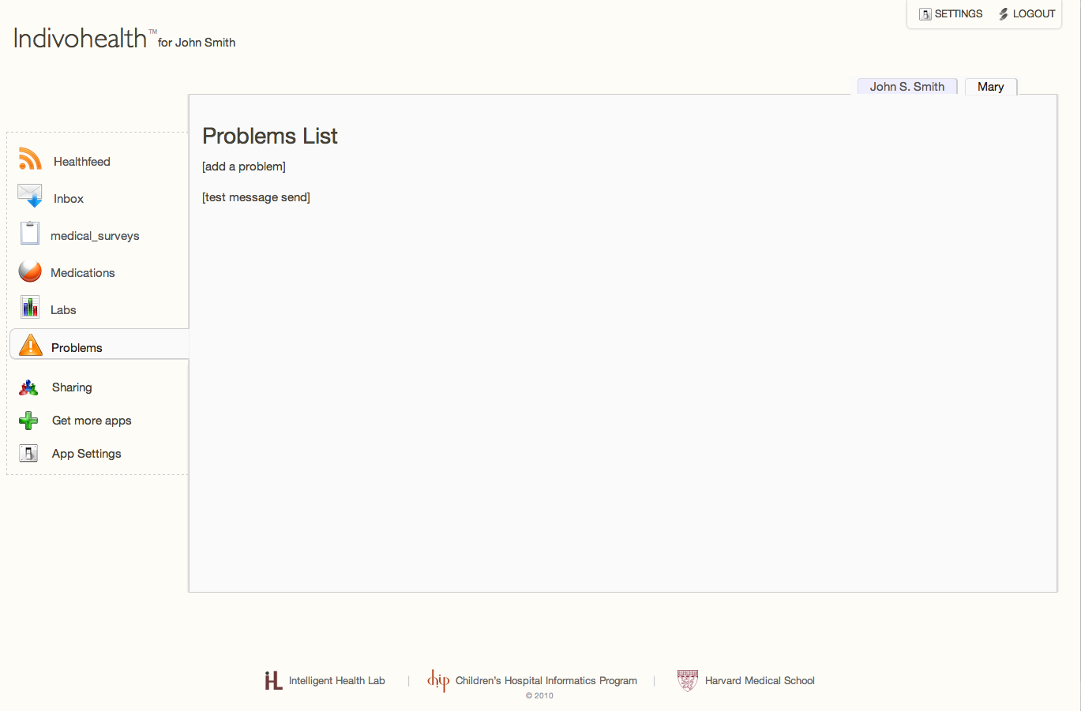
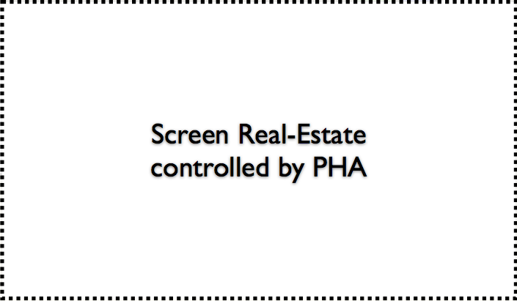

Slide 13
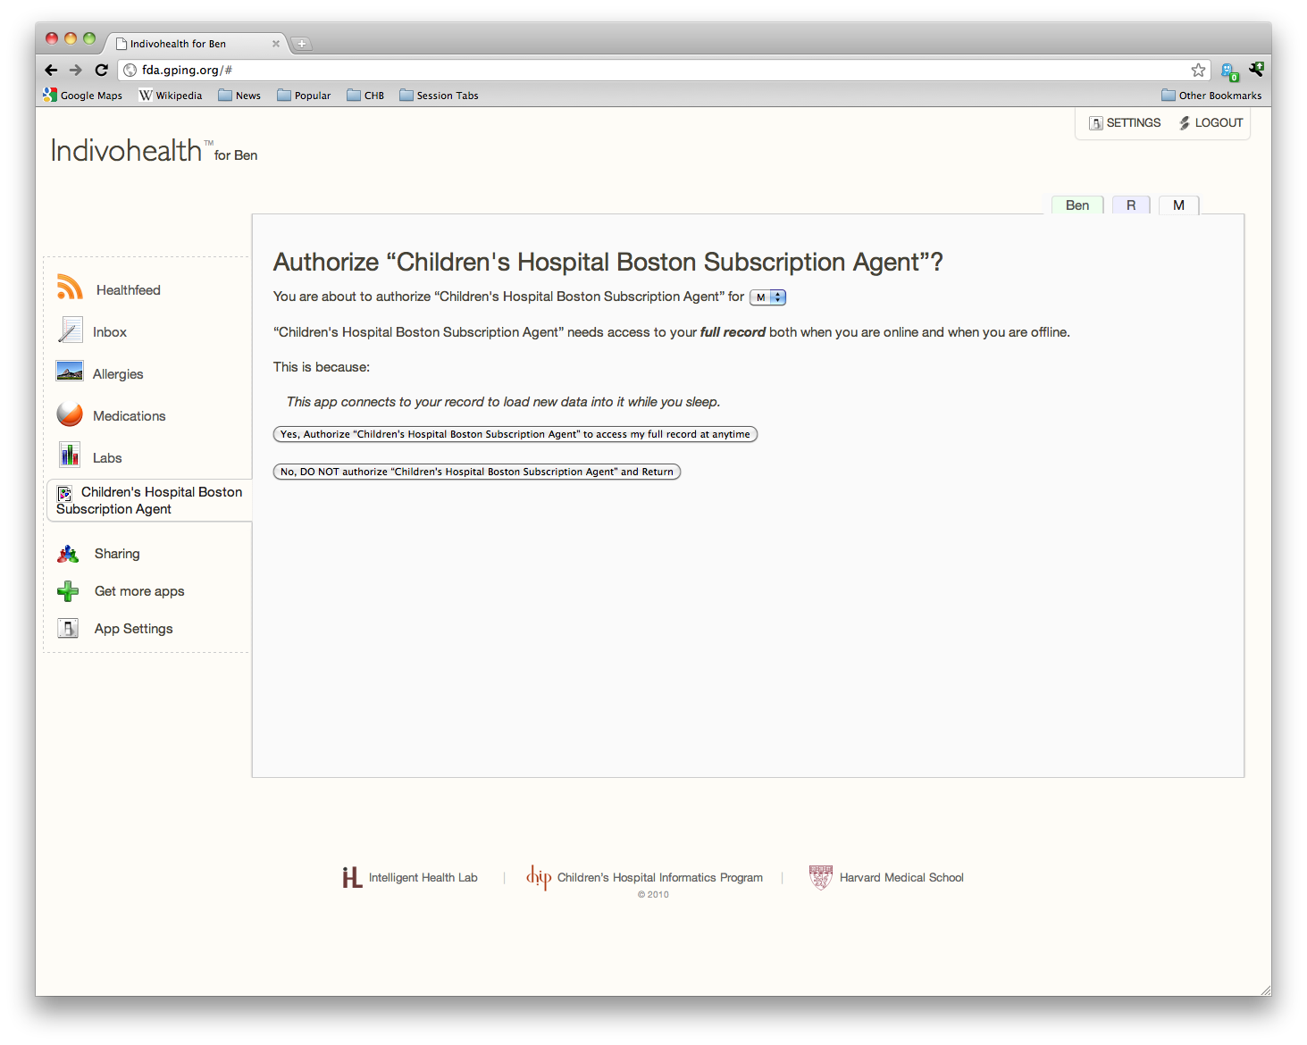
The Indivo Model: Connect

Slide 14
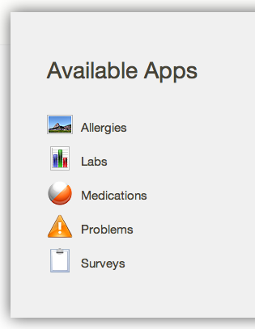
The Indivo Model: Add Apps
Apps…
  Interact with data
  Live in the UI (or not)
  Use the Indivo API

Slide 15

The Indivo Model: Share
Full Share:
  Give full control over a record to another account
  Goal: allow multiple accounts to ‘own’ same record.

Slide 16
The Indivo Model: Share
Carenet:
  Specific to one patient’s data
  Composed of documents, Apps, and accounts.
  Every entity in the carenet has full access to the carenet
Alice’s Record
Alice’s
Mother
Unshared
STD Tests
Alice’s Immunizations
Alice’s
Allergies
Alice’s School Nurse
AllergyGraph
PHA
Alice’s
Mother
Alice’s School Carenet
Alice’s
Father
Alice’s
Recent Labs
Alice’s Vital Signs
Personal Fitness Trainer PHA
Alice’s
Mother
Alice’s Family Carenet
Alice’s Bloodwork
Alice’s
Medications
Alice’s PCP
AllergyGraph
PHA
Alice’s Doctor Carenet
Notes:
-specify: carenet is about 1 PERSON’S DATA. Everyone in a carenet shares the same view into THAT PERSON’S DATA.

Slide 17
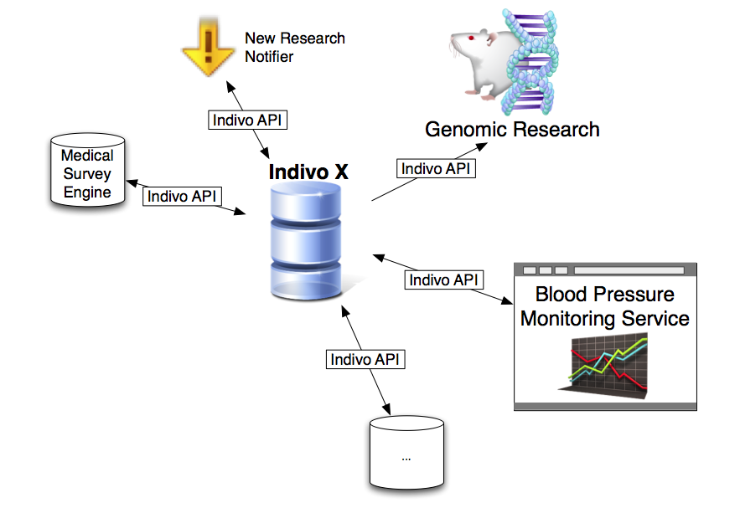
The API

Slide 18

API Functionality:
Records and Documents
List records and their attached PHAs
Create, read, replace, and archive (but not delete) documents
Associate and retrieve related documents
View metadata and history of documents
All medical documents are record-specific

Slide 19

API Functionality:
Messaging and Notifications
Healthfeed Notifications
Inbox Messages
  Message records, read from accounts
Message Attachments

Slide 20
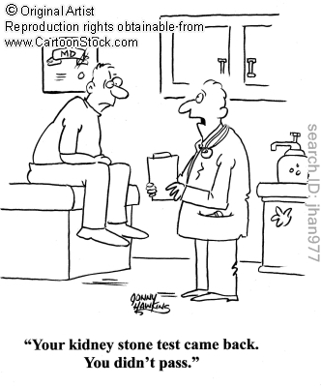
API Functionality:
Medical Reports
Reports: views into medical data
Available reports include:
Allergies
Labs
Medications
Immunizations
Procedures
Vitals
Report Generation:
Document Processing

Slide 21
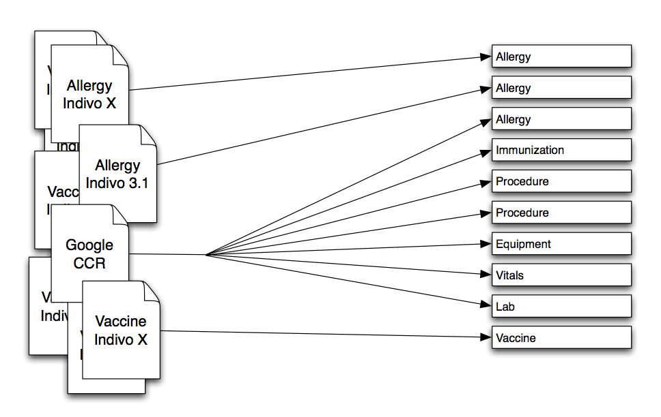
The Document Processing Pipeline
Incoming Documents: Indivo Schemas
Parsing Facts from Schemas
Generating Reports: Fact aggregation

Slide 22

Security
Goal: No one may access information that they do not have the right (via ownership or sharing) to access.
Breaks down into two processes: Authentication and Authorization.

Slide 23
Authorization
Desired Resource (document)
Request Principal (Alice’s Account)
Desired Action (Replace)
Authorize or Deny
Indivo Access Rules:
Can Principal perform action on resource?
Notes:
-goal: make life easy for developers of Indivo functionality

Slide 24
Client Libraries
Abstract out oAuth, REST
Available in python, java, working on ruby
JLInX (from Orange Labs): java POJO

Slide 25
What do we get from all of this?
Powerful apps
Ability to engage developers untrained in health care data flows
Ease of switching in new, better apps
Notes:
-perhaps I’ve convinced some of you that the app model is a good one, but I’m sure there are skeptics in the room wondering whether app construction is as lightweight as I claim.
-(Challenge Accepted). I’ll put my money where my mouth is: let’s build an app.

Slide 26
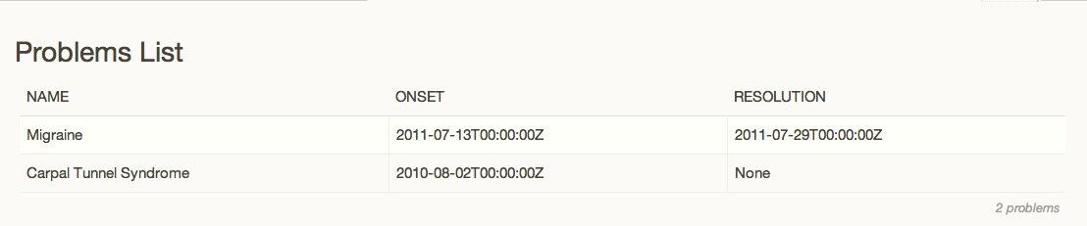
So Let’s Build An App
The “Problems App”: Lists your medical Problems
Python-Django app (we love our Django)
HTML template, one helper function, and a few lines of oauth-handling omitted.

Slide 27
Set Up the Client
def problem_list(request):
client = get_indivo_client(request)
record_id = request.session['record_id']
# get basic record info from Indivo
record = parse_xml(client.read_record(record_id =
record_id).response['response_data'])
record_label = record.attrib['label’]

Slide 28
Make the API Call
# get the list of problems from Indivo
params = {'order_by': '-date_onset'}
problems_xml = client.read_problems(
record_id = record_id,
parameters=params
).response['response_data’]
problems_et = parse_xml(problems_xml)

Slide 29
Parse the Data
# go through the problems and extract the name,
# date onset, and date resolved
problems = []
for p in problems_et.findall('Report'):
new_p = parse_problem(p.find('Item/Problem’))
problems.append(new_p)
# get the total number of documents returned
summary = problems_et.find('Summary')
num_problems = summary.attrib['total_document_count’]

Slide 30
Display the Data
# Format the data in an HTML template and display it
context = {'record_label': record_label,
'num_problems' : num_problems,
'problems': problems}
return render_template(’problem_list’, context)

Slide 31
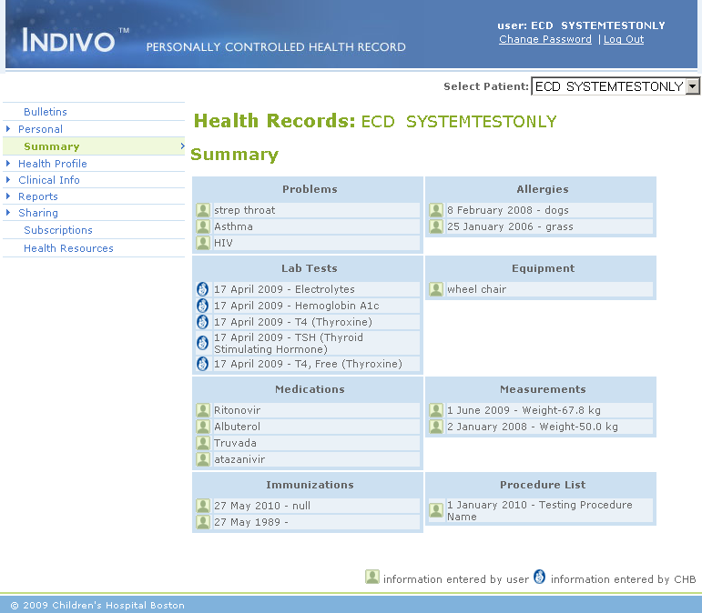

Slide 32
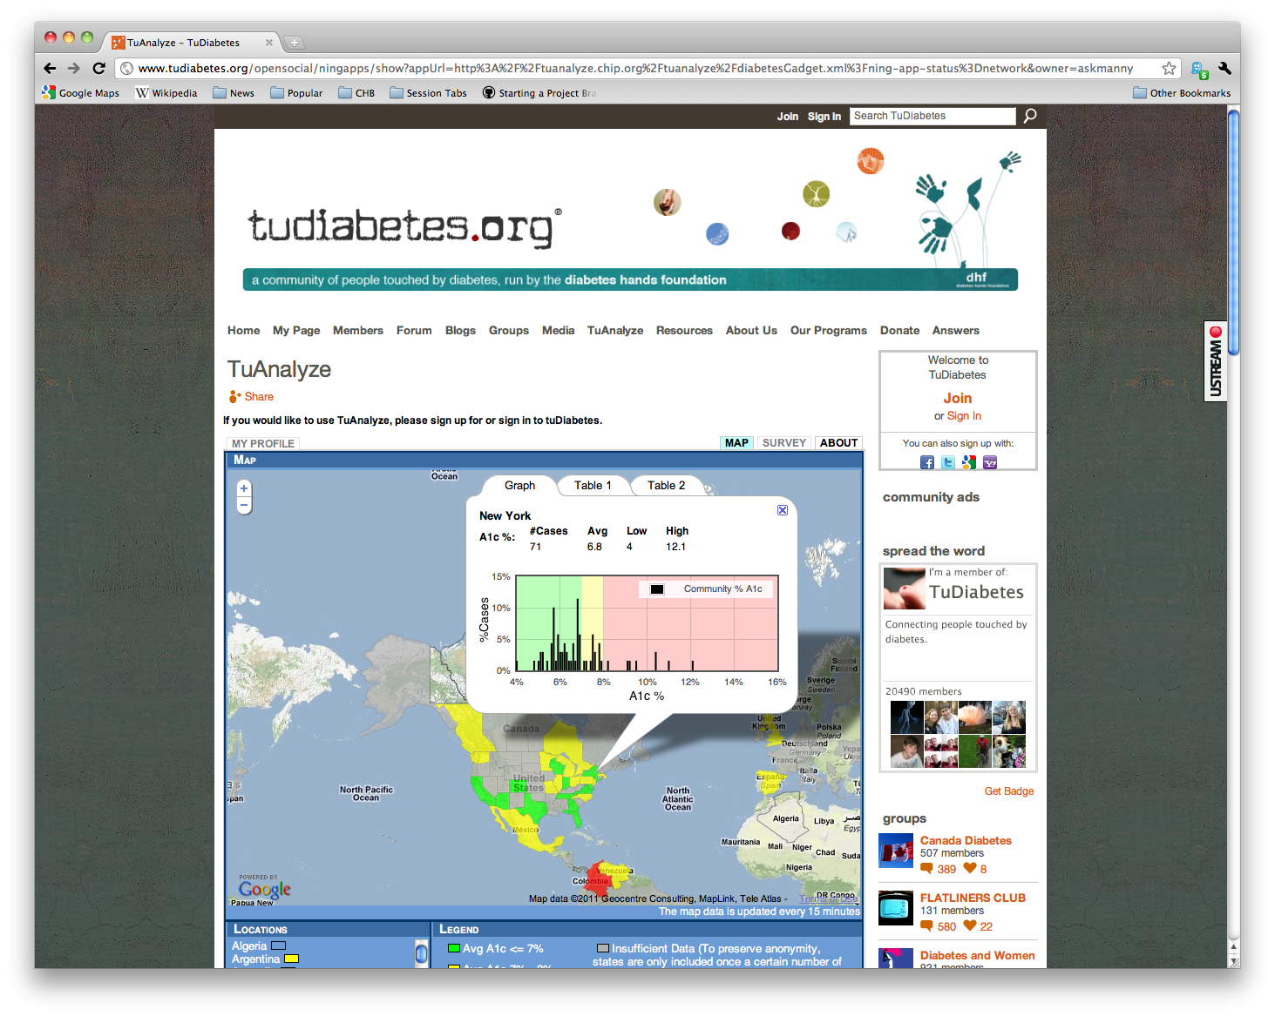

Slide 33
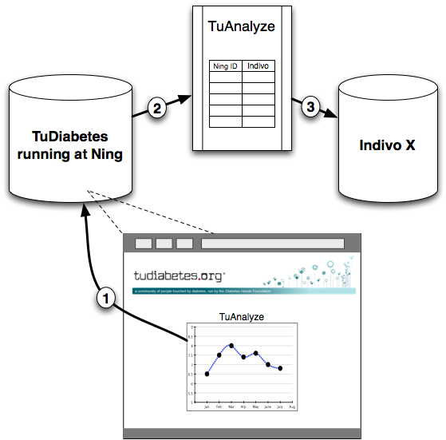

Slide 34
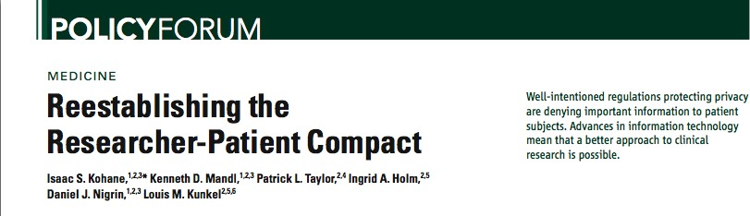
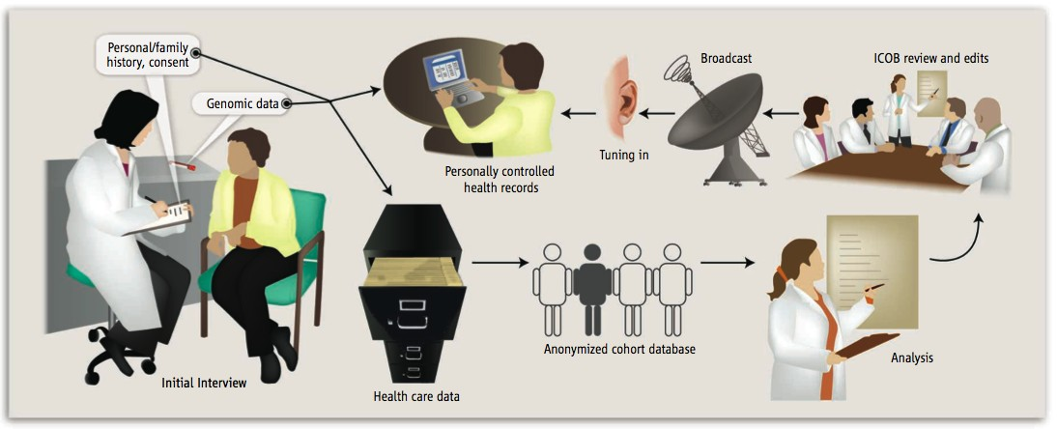
The “Longitudinal Phenotype”
Notes:
-feed incidental findings in genetic studies back to the patients
-patient control: patient decides what information they will receive

Slide 35
We are extending the Indivo Model
to EHRs—
“The App Store for Health”
ONC Funded Research Project under the
“SHARP” program
Notes:
-Substitutable apps can run anywhere: not just on Indivo
-emphasize avoidance of vendor-lock: if you can easily substitute value-generating apps, you don’t need to depend entirely on a vendor with possibly different priorities

Slide 36
Where We Are Now
Code on github
Building a community
  Forum for discussion and code review
  Developer Resources (upcoming O’Reilly eBook)
  Partnerships with other orgs
  Talk at OSCON
  App Challenge!
    $5,000 Prize (sponsored by Recombinant Data Corp)
    Hosted on Challenge.gov
    Dates TBA
Notes:
Partners:
-MIT Media Lab -Mass DPH
-Orange Lab -Dossia
-Johnson and Johnson

Slide 37

Bootstrapping a Community
Chicken, Egg, or Both at Once?
The Health IT problem
Photo Credit: Dennis Novak/Getty Images
Notes:
-Chicken: Contribution to the project (Writing code, reporting bugs, making feature requests, etc.)
-Egg: Management of the contributions (code review, bug tracking, feature requests, etc.)
-Both: Get contributors to become managers
-Health: Developer pool is much smaller: need technical people also interested in health care—this is why we’re focused on making app development easy: you need to care about healthcare, but not be an expert in it.

Slide 38

Where We’re Headed
Large-scale Population Health Research
Innovative functionality in the clinical setting
Integration into the patient world
  Mobile
  Medical Devices
Notes:
TuDiabetes, Indivo+Carranet (60 site registry of patients with pediatric rheumatic diseases)
BP Centiles / Cardiac Risk apps, ED surveys project.
Orange Continua App, Implications of a mobile world
As a developer on the Indivo team, you can expect to get involved with ALL OF THAT!

Slide 39
Get Involved
Our community lists
indivohealth@chip.org, indivo-announce@chip.org
Tell us about your apps! http://wiki.chip.org/indivo/index.php/Developer_Community_Projects
  Email project descriptions and links to info@indivo.org
Get ready for the Indivo App Challenge!
Look out for the eBook
Help us develop Indivo: http://www.github.com/chb/
Just learn more: http://www.indivohealth.org

